Slide 1
State of the web 2014
Notes:
Hello Everybody. Thanks for checking this video about the State of the Web 2014
JavaScript Fact:
Fun fact: JavaScript was released on September 18th 1995 with Netscape Navigator 2.0. Even before Internet Explorer 3 was released that year.
Netscape 2.0
September 18, 1995
Including JavaScript support, Java support, plug-ins, integrated Messenger / Collabra, Auto-dither, Live3D. Support for font color, div, wrap and textarea tags. Superscript / subscript, Animated GIF
CSS Fact:
Internet Explorer 5
2000
Full support of CSS 1 standard
HTML fact:
1980
First Memo stating internet based hypertext system at CERN
1993
First proposal for HTML specification

Slide 2

State of the web 2014 HTML5, SASS, NodeJS, Grunt, Bower, AngularJS
Martin Spierings
Mobile software engineer
Sogeti Nederland B.V.
October 2014
Notes:
My name is Martin Spierings. I’m a Mobile Software Engineer at Sogeti Nederland.
I would like to show you guys some new things involving the web.
I’ve been working with some great new things and wanted to share them with the group.

Slide 3
Contents
The Web in 2014
Tech
HTML
CSS
SASS
JavaScript
Demos
Future of web
Notes:
So what am I going to talk about
-News about the web
-New HTML tech
--Like SASS, AngularJS and more
-Some demos
-Future of the web. Stuff to start learning or look into
-And a few other things

Slide 4
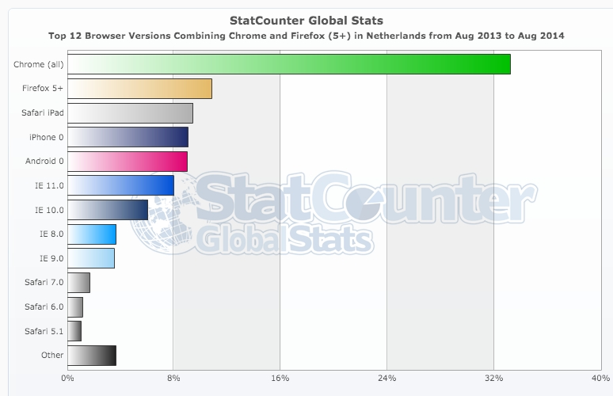
The web in 2014
Trends:
Increased mobile support
Mobile-first design
More sites utilizing HTML5 features
End of life WinXP -> Bye bye IE9
Google Forces Android 4.x on budget
New:
Android L
iOS 8
Windows Phone 8.1
Notes:
So whats new for the web in 2014?
Increased Mobile support
-More devices online
-More new features supported in browsers
Mobile-first design
-More sites and apps start with mobile dimensions and work their way up
-They also support touch and other device features
More sites utilizing HTML5 features
-Like font-face
-Like Video
End Of Life Windows XP
-No more support for Internet Explorer 9
Google Forces Android 4.x
-Android 2.x and 3.x are dying out
New mobile operating system versions
Android L -> Material Design
-New way for content to animate and interact
As you can see by the graph the older browsers have limited support now. Chrome is most popular.

Slide 5
HTML
 | 2012 | 2013 | 2014 | 2015 | 2016
HTML 5.0 | Candidate Recommendation Separated specs | Call for Review | Stable Recommendation |  | Finished
HTML 5.1 | 1st working draft |  | Last call | Candidate Recommendation | Recommendation
HTML 5.2 |  |  |  | 1st Working draft
Notes:
In 2014 HTML5 will reach a stable recommendation. Its one of the final steps in the validation process
It will be officially finished in 2016
The HTML5 spec has separated a few items to new branches
-Canvas – for drawings and visual objects
-Storage – for locally storing files or databases
-Socket & Webworker – for creating real time communication (push-connections from server to client)
-WebRTC – the protocol for RTP communication (streaming audio/video)
-Media – the video and audio tags with codecs. For playing static media files

Slide 6
CSS
Better focus on using GPU
Use less JavaScript
CSS4 proposal
Responsive design became mainstream
Fit to browser dimensions
Increase mobile usability
Show or hide elements depending on screen format
Notes:
Doing transitions with the GPU or painting with the GPU increases performance dramatically. Especially on devices with advanced GPU and multi-cores.
Using Javascript visual manipulation seems to be over. Though new progress has been made which could make Javascript even faster than CSS for transitions. Polymer for example.
A new CSS standard is being made with lots of new features like pointer-events, for handling multiple kinds of input devices
Have functions and variables in CSS to shorten developtime
New selectors for selecting content and applying styles to them. With a big focus on selecting most but not all or selecting element childs or parents
Removing unneeded handles for faster performance
http://samuli.hakoniemi.net/peek-into-css4/
http://vandelaydesign.com/some-interesting-possibilities-with-css4/
http://www.sitepoint.com/css-selectors-level-4-the-path-to-css4/

Slide 7
SASS / SCSS
Syntactically Awesome Style Sheets
Supercharge your style sheets
Do Not Repeat Yourself
Clean Structure
Maintainable
True import
@import ‘base’;
.item{
color: $primary-color;
li{
display: inline-block;
width: 150px / 400px * 2;
a{
@include background-gradient(
$primary-color, $secondary-color
);
}
}
}
}
.error{
@extend .message;
background-color: red;
}
Notes:
Nesting
Variables
Partials
Import
Mixins
Inheritance
Operators
Preprocessing
SASS or Syntactically Awesome Stylesheets appeared in 2007 as an extension for CSS, much like LESS. But where LESS is compiled on client-side, SASS is compiled on the server or during development. SASS is also known as SCSS where the syntax follows the normal CSS styling principles as SASS doesn’t have block formatting (or curly brackets). SASS is made in Ruby but is currently being converted to PHP, C and Java. The C version isn’t on par with Ruby but contains most features.
So why use SASS?
As you can see in the example, it allows you to nest your content. Making it a bit better structured and needing less code
It also allows for variables. So you can define your basic colors and use them more easily. You can then also update those colors all at once
You can import other SASS files so you can split your css up in multiple files. After compilation they get combined to a single file. Thus removing the negative side of normal CSS imports.
You can use mixings, simple functions, to ease some functionality. Like making a function for gradients to insert 2 colors and get the code automatically. Or create a loop of some sort.
Inheritance is inspired by object oriented programming. By extending a block of code inside another block.
Operators allow you to calculate with values. Combined with variables allows for flexible layout
Preprocessing is the proces of compiling the SASS files to a single CSS file which has a few neat options. You can generate a map-file so the devtools show you where the real rule is defined or remove whitespace and comments. Or remove unneeded styles. Or combine styles if defined separately for a single element. This way you get the smallest possible stylesheet in production.
http://sass-lang.com/guide

Slide 8



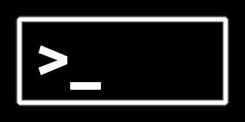






JavaScript
Notes:
So now I’m going to talk about JavaScript. And mostly the new things that came out the past few months and years which are making things much easier.
JavaScript has changed much the past years. It first came to life with Netscape 2 back in 1995, but the biggest changes probably started a few years ago with Webkit. This is the browser-engine from Safari, made by Apple, and is now also implemented in Google Chrome and Opera. Its main competitors are Trident from Internet Explorer and Gecko from Firefox. With Webkit a small project called Node.JS came to life

Slide 9
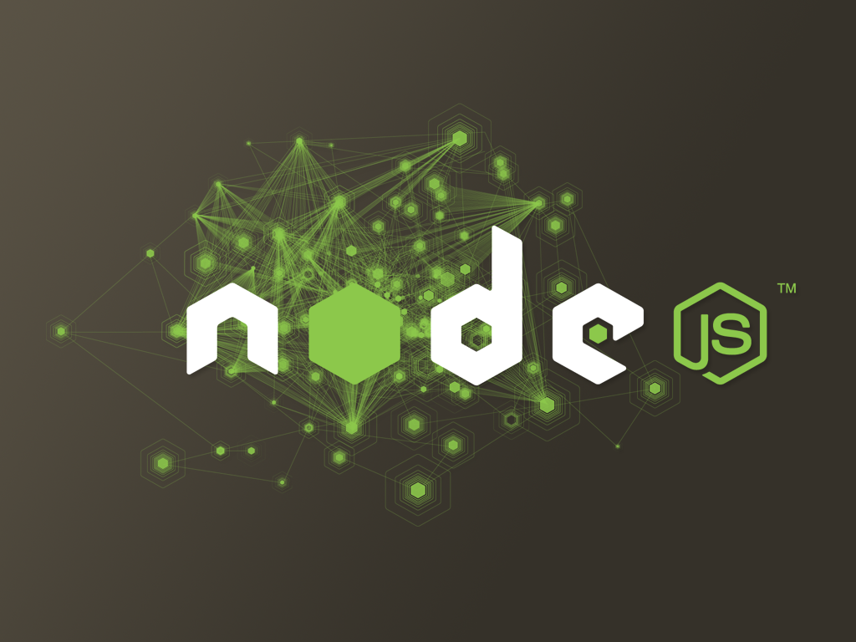
JavaScript: Node.JS
Portable Webkit engine
Platform
Cross device/OS
Run JavaScript applications
Internal webserver
Event driven, non-blocking I/O
Even runs on Hardware (https://tessel.io/)
Notes:
NodeJS was created by Ryan Dahl in 2009. Ryan was browsing the web and noticed an upload bar on the popular image-host Flickr. The browser couldn’t know how much of the file had been uploaded so it was continuously polling the server for a progress update. Dahl wanted an easier way. The main idea of NodeJS was giving websites push capabilities like seen in Gmail.
Basically NodeJS is a portable version of the Webkit engine, which is able to do non-blocking Input Output. And by that we mean that running multiple clients that send requests, are handled simultaneously. You can have multiple clients doing multiple things without having to handle each request separately. This allows for great performance when serving multiple clients. And because its running on Javascript, it can run on pretty much anything. And lately, some projects have started that use JavaScript on the hardware-level like Arduino or Raspberry Pi.
https://tessel.io/
http://www.toptal.com/nodejs/why-the-hell-would-i-use-node-js

Slide 10
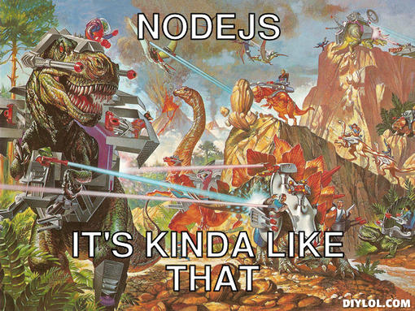
JavaScript: Node.JS
What for?
API (REST)
Mobile
Backend
Frontend
Hybrid App
Web App
Web
Server
SPA
Internet of Things
Devices with network connection)
Notes:
So why use Node?
Its great for running web-related stuff with little resources and less-complex matters. It isn’t really suitable yet for big business information systems, but you can easily use it as a backend for your website or webapp. Its fairly easy nowadays to run a REST API or connect various devices.
It can be used for front-end and backend or whatever is in between.

Slide 11

ExpressJS
Extended webserver for NodeJS
REST API
GET data
SET data
UPDATE data
DELETE data
Webserver
/user/1/edit
/somefile.txt
Notes:
ExpressJS is a module for NodeJS to create a webserver with ease. Its easy to load, easy to run and easy to maintain. Especially for smaller projects.
It can be used as a REST API to output JSON and communicate with various clients
It can also be used as a true webserver in combination with some other modules to run a website.
And of course it runs on JavaScript.

Slide 12
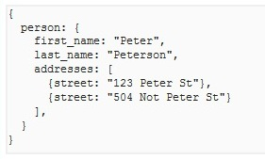
MongoDB
Popular NoSQL database in JavaScript
JSON
Indexes
Scaling
Querying
CURD
Security
Runs as separate service
Other database libraries for NodeJS are available for Redis, PostgreSQL, MySQL, MS SQL
You can also use alternatives like NoDB and alike.
Notes:
A quick sidestep but still important: when using node you might want to save data and use that throughout your app or website. One way to do that is with MongoDB. It’s a cross platform document-oriented Database. Its classified as a NoSQL database but features JSON-like documents with dynamic schemas. It talks in JSON so is very easy to connect to NodeJS. It has a few other features that allow for developers to use it differently. Giving them high performance and ease of use.
If you want you can also use other databases with NodeJS like MySQL.

Slide 13
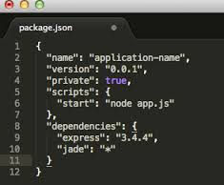
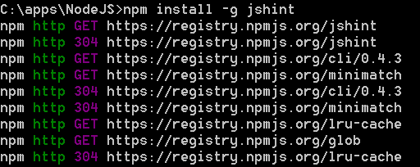
NPM
Node Packaged Modules
Package manager for NodeJS
Install packages from NPM Registry (npm install … )
Dependency of dependency of dependency of dependency
Globally or within project (package.json)
Use with Sudo on OSX to install packages globally
Notes:
With node comes NPM, the index for node modules. Its available in the commandline and can be configures using a package.json. Inside you have some information about the project and what kind of dependancies it has. You can even start other tasks on completion, allowing for chaining various commands. NPM can also generate a package.json to get you started.
One thing to note is that the dependency could have dependencies itself so you’ll end up with a dependency inside a dependency inside a dependency inside a dependency (or longer).
So why use it? To allow for your team to include these dependencies but leave them separate from the project. You don’t need these packages on your repository and can set what version you want to use so you won’t mix up the versions.

Slide 14
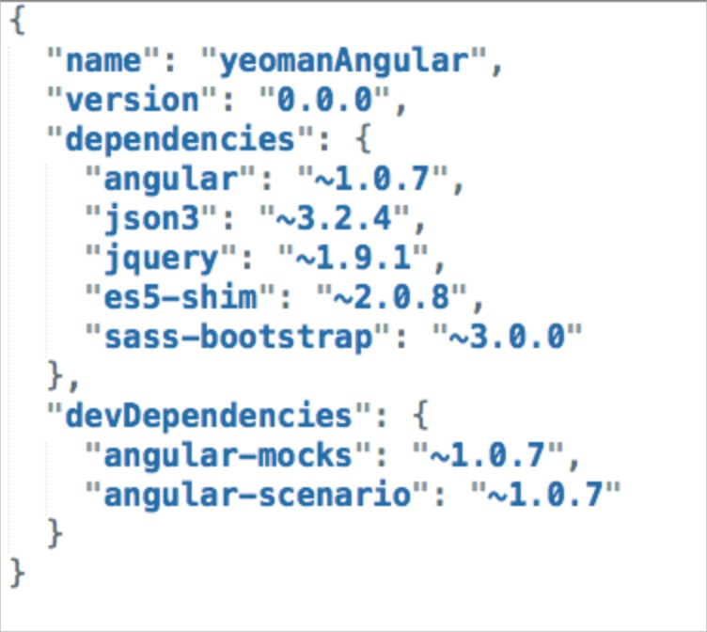
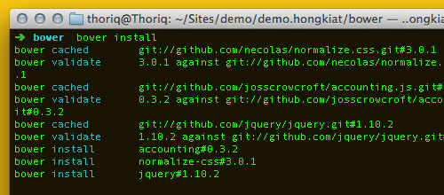
Bower
Package Manager for Browser components
Assets
Frameworks
Libraries
Utilities
Why not NPM?
Flat dependency tree
Single version, no additional dependencies
Specifically for front-end
Bigger community for front-end
Notes:
Bower, not to confuse with Jack Bauer, is also a package manager, but Bower is optimized for the front-end
It allows for defining front-end dependencies. You can find all kinds of projects here but most popular are jquery, angularjs, bootstrap and d3 (javascript visualization library for html and svg).
The big difference with NPM is that these dependencies don’t require dependencies themselves, so you’ll get a flat dependency tree. And the community for front-end libraries is much bigger.

Slide 15
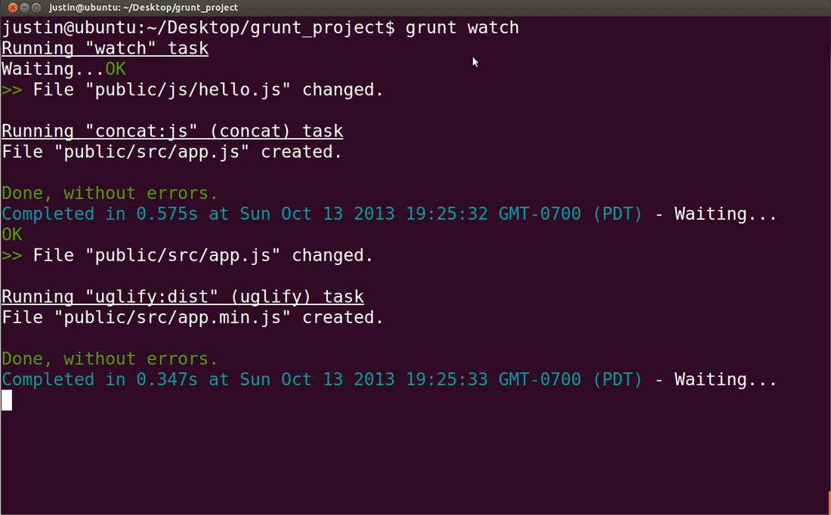
Grunt
Taskrunner for automating repetitive tasks
Lots of modules
Once or continuously
Use during development
Use to generate production package
Create, modify, watch, generate, test, clean, optimize and more
Has upcoming alternative: Gulp
Notes:
Grunt is an amazing piece of work. It’s a handy tool to use for running repetitive tasks.
In your project you might want to separate development with production and with Grunt you are able to differentiate. You can use it to make a distribution package or create different tasks so you can split up your project. It uses modules to implement different kind of features. These modules can be retrieved using NPM.
Alternative for Grunt would be Gulp at the moment which is a bit different and prefers code over configuration (grunt is configuration over code). Plus it has a heavy focus on simultaneously running things.
Some cool features:
-Beautify your code so every code in your project is similar
----Setup your coding standards and let grunt automatically clean up your code.
-Compile your SASS into CSS files-Apply linting, let Grunt look for errors and make sure the code runs
-Combine your files to include only a single one, keeping the amount of requests low.
-Live reload your code. Refresh every browser connected automatically and recompile your SASS
-Minify your HTML, CSS and JavaScript
----Remove all whitespace, remove unneeded code, remove comments and more to get the smallest files possible.
-Watch certain folders for changes so you can reload your clients or start various other tasks. Press save and watch the magic.
-Generate a separate distribution with all things needed for a single package
-Start other tasks simultaneously or chain them for best results. Create an installer and make sure you are set to go
------------------
Lint as a term can also refer more broadly to syntactic discrepancies in general, especially in interpreted languages like JavaScript and Python. For example, modern lint checkers are often used to find code that doesn't correspond to certain style guidelines. They can also be used as simple debuggers for common errors, or hard to find errors such as heisenbugs.

Slide 16

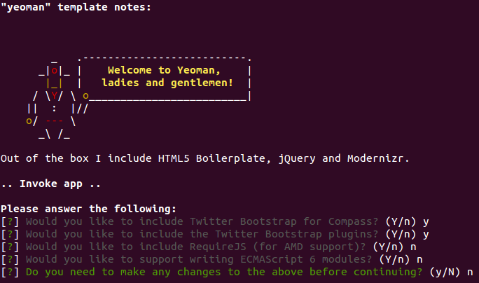
Yeoman
Scaffolding and generator for webapps
Command line
Vast amount of generators
Updating
Automating
Notes:
Yeoman is a nice and simple scaffolding tool for webapps.
It allows for generating a vast amount of frameworks and libraries. You can easily setup an Angular project and generate your content via the command line. Or run certain tasks to develop or distribute your app.
You just run a command, get a couple of questions and the magic starts. More in the demos

Slide 17
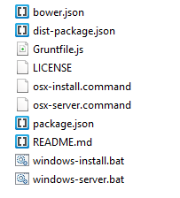
Automate the automation (DIY)
Easy install and starting up by single-click
Testers make less mistakes
Different files for different actions, user login, setup mode, etc.
Install, update, change dir, run grunt task, run node commands, etc.
Using batch files to enable single-click install
OSX: install.command
Windows: install.bat
Using batch files to enable single-click startup
OSX: server.command
Windows: server.bat
Notes:
Make it easy for yourself and your team to create single-click executables.
Testers click a file and it installs
Testers click a file and the project starts
Testers click a file and they are now using the project as a admin, or low-level user

Slide 18
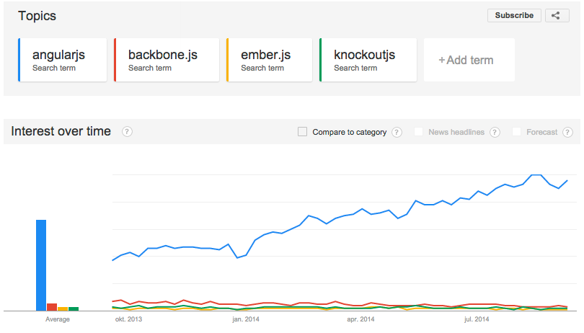
AngularJS (1): What? Where?
Front-end Single Page Application framework
JavaScript MVVM/MVC
Backed by Google
Popular
Not meant for plain websites
Great for
Dashboards
Frontend for data-app (CRUD)
Standalone and offline app
Creating frameworks
Mockups
Notes:
AngularJS is a front-end single plage application framework. This means that it’s a client-side javascript framework for making app-like websites.
For those familiar with the principles, it’s a MVVM or MVC framework. (more MVC than MVVM).
One important thing to note about the project is that its currently being backed and maintained by Google (employees).
And that its primarily meant to create Single Page Applications or Enriched webpages and not plain websites. Mainly because it relies on Javascript, which needs to be enabled, and indexing is still subpar.
Where should you use it?
Its great for creating interactive dashboards
For creating a front-end for accessing and manipulating data in a database. Say a note-taking app or customer database
Its great for creating an offline webapp or use it in Phonegap
Its easy to build simple app mockups to show your client what you are going to make.
For most of these its worthy to note that you require some extensive knowledge of the framework and might want to use this as a starting point for your own framework.

Slide 19
AngularJS (2): Highlights
2 way data binding
Directives
Modular
Fast
Asynchronous handling
Dependency Injection
Nesting code and separating files
Syntax close to JavaScript and jQuery
Clean structure, easy to manage
Easy to learn (hard to master)
Production-ready
Big community
Very active development
Well integrated in Phonegap (especially with ionic framework)
Notes:
Some highlights:
2 way data binding: connecting the view and the model
Use directives to declare custom html elements. For example: you can create an element <widget> for your easy reuse
Modular by design. Require what you need and keep it simple
Its fast on modern browsers, could create an native-like feel
Can asynchronously handle data, keeping the app feel responsive
Dependency injecting. Some might know this with Java or DotNet
You can separate your code into multiple files and include them or even nest them for multiple levels
The syntax isn’t much different from normal Javascript or jQuery and is easy to get into
It has a clean structure, is well thoughtout and easy to manage your project
Its easy to learn. Lots of starter-tutorials. Many of them share code or contain video
Production ready, big companies already use it
It has a big community which is very helpful
Has a very active development. Maintained on Github so everybody can join in and is very open
It can integrate very well with phonegap to use it for hybrid apps. Especially the ionic framework which has AngularJS as a base

Slide 20
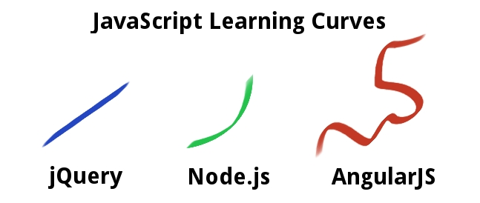
AngularJS (3): Downsides
Hard to master & learn by doing (or failing)
The AngularJS way can be odd at times
Doesn’t prevent you from writing lousy code
Its still JavaScript
Browsers will still have bugs
Connecting to backend can be confusing
No lazy-loading, everything needs to be loaded for it to work
Performance on big projects can be degraded
Doesn’t really index properly in search engines (yet)
Requires JavaScript to be enabled on the client
AngularJS 1.3 or 2.0 promise improvements on almost all fronts
Notes:
AngularJS isn’t foolproof and still has some issues to overcome
-While it is easy to learn, you’ll have a hard time mastering it. Most tutorials are very basic and there aren’t many big-app examples. There is lots of trial&error involved
-Its still Javascript. Not every browser does that well and there are some platform-related issues or annoyances to get around. ECMA 6 might improve some though
-Connecting to a backend API can be confusing. Especially if you need authentication and authorization
-While it is flexible, it doesn’t prevent you from making bad code. It might work but you’ll need to write your own unit tests for it to be acceptable
-Some stuff is done the Angular-way. While this might make sense most of the time, there are some weird choices you need to know about
-It doesn’t have lazyloading by default. Loading a big AngularJS application might take time or can affect performance (since everything is in the DOM)
-Since it relies on Javascript, you might have problems indexing your app. And it requires Javascript so clients who have it disabled, won’t be able to use it.
Many stuff named is going to be improved soon or soon-ish in the next versions. There are already many improvements. One of which is debugging your apps.

Slide 21

Demo time
Lets watch at some demos
Node
NPM
Bower
Grunt
Express
Angular
Yeoman
Node-Webkit
Cordova
Notes:
So I’d like to show a few demos
1 that runs on multiple platforms
1 that shows you it can run on hardware
1 that shows something about MEAN
And perhaps go into detail for some stuff we made for the latest project

Slide 22

What’s next for Web?
Shadow DOM
Polymer – Material Design
ECMAScript 6+
AngularJS 2+
Node.JS 1+
More NodeJS Modules
Better hosting
Better tools
Notes:
The future of the Web has some neat things in store. Granted, some stuff might take a while to be supported significantly and could take a few years, but still:
-Shadow DOM is a way to truly separate parts of your page. Load twitter widgets without having it mess up the rest of the page because you also used a class called “widget”. Mostly handy for external items.
-Polymer, or Material Design, will have a great effect on how we percieve an interface. Polymer also has a web-branch that we might see more. Thing is, its kind of a replacement for Javascript Modules and Angular Directives combined with the new design guidelines. So it seems that Google was a bit premature. Anyways, nice change
-Javascript Modules allow you to truly separate parts of your code so its easier to maintain and faster to load. Might be a big change for NodeJS
-AngularJS 2.0 has some big changes in store to make it easier, faster and useful
-NodeJS 1.0 has some big changes in store to make it easier, faster and useful
-More NodeJS modules will be made, making it invaluable
-Like Arnd suggested, we might not even need to separate Front-end and Backend in the future. Perhaps the only thing is a place to store your data and to get the startingpage
-Better hosting of Javascript-projects. Currently it is nowhere near as easy as DotNet or PHP hosting. Its also not cheap and allows you to not only know about making the site but also maintaining and securing it.
-Better tooling to create these new projects. Its currently heavily focussed on commandline or textbased tools.

Slide 23
Live long and use Web Technology
Notes:
I hope you guys enjoyed this presentation and know a bit more about the current state of the web.

Slide 24
Notes:
Some hidden slides will follow for those looking for more information or a bit more detail.

Slide 25
The Basics (few years ago)
Server (logic)
Logic
Database
Client (static)
HTML
DOM
CSS
JavaScript
Notes:
A decade ago most server/client communication looked like this
The server contained all information and compiled everything into a simple package
Which was then sent to the client as static files
The Client was mostly dealing with plain files.
-HTML for structure and content
-CSS for styling
-Javascript for DOM Manipulation
DOM = Document Object Model

Slide 26
The Basics (now)
Server
Automation
API
SASS
Database
Client
AngularJS
Logic
REST
Dynamics
DOM
Assets
HTML
CSS
JavaScript
Notes:
Nowadays the client has a bit more to do but the server is more active too.
The server is used for automating various tasks. For both development as production
It runs an API which the client can connect to to get its data or change it
It runs SASS to easily update the styling
It runs the database for use on server and client.
All can run as JavaScript by the way
Then the client is separated between AngularJS (or another framework) and the plain assets from before. It now has application logic, REST communication and makes dynamic content available so it acts like a true app.
Since the clients are now much faster, we can let them do much more. Much like native-apps handle most of the stuff.

Slide 27
Result?
Closer to native
More features
Standalone
Offline use
One size fits all
Easier to maintain
More professional
Improved UX
Longer development
More devices to support
More browsers to support
More code to make
More difficult
Lots of frameworks
Lots of different code standards
Lots of pioneering
Complex tooling
Learn by doing (learn by failing)

Slide 28
Grunt
Taskrunner for automating repetitive tasks
Beautify to coding standards (HTML, CSS, JS)
Compilation (SASS)
Combination (JS)
Linting (code analysis)
Live reload (all connected clients)
Minification (HTML, CSS, JS) Unit testing
Watch folders (Beautify, Lint, Compile, Livereload, test, restart servers)
Generate distribution (Check, Compile, Minify, Combine, Copy, Zip)
Starting servers (Backend, Mock, fileserver, serve front-end)
Notes:
Grunt is an amazing piece of work. It’s a handy tool to use for running repetitive tasks.
In your project you might want to separate development with production and with Grunt you are able to differenciate. You can use it to make a distribution package or create different tasks so you can split up your project. It uses modules to implement different kind of features. These modules can be retrieved using NPM.
Some cool features:
-Beautify your code so every code in your project is similar
----Setup your coding standards and let grunt automatically clean up your code.
-Compile your SASS into CSS files-Apply linting, let Grunt look for errors and make sure the code runs
-Combine your files to include only a single one, keeping the amount of requests low.
-Live reload your code. Refresh every browser connected automatically and recompile your SASS
-Minify your HTML, CSS and JavaScript
----Remove all whitespace, remove unneeded code, remove comments and more to get the smallest files possible.
-Watch certain folders for changes so you can reload your clients or start various other tasks. Press save and watch the magic.
-Generate a separate distribution with all things needed for a single package
-Start other tasks simultaneously or chain them for best results. Create an installer and make sure you are set to go
------------------
Lint as a term can also refer more broadly to syntactic discrepancies in general, especially in interpreted languages like JavaScript and Python. For example, modern lint checkers are often used to find code that doesn't correspond to certain style guidelines. They can also be used as simple debuggers for common errors, or hard to find errors such as heisenbugs.

Slide 29
AngularJS (1)
Front-end Single Page Application framework
JavaScript MVVM/MVC
Module-based
Backed by Google
Separating HTML from JS → view
Two way data binding → $scope
Browser
Angular
Server
Notes:
You’ve might heard me talking about it a few times but what is AngularJS?
AngularJS is a front-end single plage application framework. So what does that mean? It allows for making web applications that act like standalone applications. It sits between what the user sees in the browser and the server.
Where a lot of the logic that was previously on the backend, is moved to the frontend. So why would you do this? Because this allows you to make it truly feel like an app, not a collection of pages. Because this allows you to deal with a great variety of browsers and thus users to use your app. It might have an odd learning curve (like the graph states), but don’t let that stop you. Tutorials are improving, the code is being revamped and the project is getting more professional each day.
Its basically a Javascript Model View Controller (or ViewModel) framework.
Its module-based, meaning that you only take the stuff you need.
And its backed by Google, keeping the framework free and with an active development.
Views in angular allow you to split logic from templates and content. I can have normal HTML to build my page and use CSS to style it. I don’t require another language or template engine to setup my views.
It provides for two-way data binding, which means I have a single variable I can use in my logic and in my template. I can change it in both my view and my controller and it will update in both places.
Pretty much all the big companies are using it these days, including Apple, Google and Microsoft.

Slide 30
AngularJS (2)
The basics:
App
Config
Routes
Filter
Directive
Factory
Service
Controller
HTML page
Notes:
So what does it look like. Well, I could show you a piece of code but that might not make sense.
So here’s an overview of what basic components are used in these AngularJS applications
First the html page. It often doesn’t contain much but loading the javascript and seting up a basic structure.
Than the app itself, it is initiated on page load and connects everything.
Then the configuration. It contains the stuff we need on a global level. For example: handling the translation we need or loading some variables we might need everywhere.
The routes makes sure we can use multiple pages or views and connect a controller for the logic.
The controller is what makes a single page have logic. Connect the data to the view, do calculations and transform input to output.
The filters enable you to convert data to something you want to display. Convert to a date or time, set amount of decimals, transform to uppercase or load a specific translation. It doesn’t change the value but rather transforms it into what you want to show
The Directive is something special. It extends HTML to have more elements or attributes. So if I want to make a new element called <mainmenu> and add some logic and structure, I would use a directive. If I would like to modify it, I could add an attribute so my label not only shows text but also if its associated field is correct or not. It allows you to extend html or implement more logic without losing sight of what is html, what is css or what is javascript. It removes the need for using jQuery to manipulate the dom.
Factory and services allow you to retrieve data (say an REST API) and store it persistently. So when I login as a user, my data can be used cross the app. It can also be connected to localstorage so you don’t need to be online or retrieve the same data over and over.
Inside the Controller I can refer to these factories and services, so I only need to code them once.

Slide 31
AngularJS (3)
Collection of components
Ng-app Bootstrap as application
Ng-model Two way data binding
Ng-controller Attach controller.js file
Ng-form Group form controls for validation
Ng-click Use expression to execute on click
Ng-repeat Collection of items to list
Ng-if –show –hide –switch Expression to show/hide content
Ng-include Include html file
Ng-filter Filter or parse value for display
Expression {{ somethingToExpress }}
Notes:
Angular has a few components for you to use
These components are setup like directives so we can insert them like they are normal HTML inside our view.
So some examples?
Ng-app allows you to define your application. It allows Angular to know: ok this is an app, we need to do some stuff for that.
Ng-model is the two-way binding I talked about earlier. It contains a data variable (var, as string, array or int) which you can use to connect to an element. So if I have an input element for typing a name in a field, I can use ng-model to refer to it as a variable.
Ng-controller allows you to attach an external controller. Normally you can already attach a controller with the route but if you want to use a controller inside a controller you can do that. This way you can separate your code even more.
Ng-form binds a few handy variables to your form and form elements so you can use front-end validation
Ng-click replaces the on-click event from javascript and allows you to call functions in your controller
Ng-repeat allows you to go through a list of items (an array) and do something for every item in the list. So you can make a nice list of menu-items or create a nice table.
Ng-if ng-show ng-hide and ng-switch allow you to handle the display or logic of data you want to display. Say I have a menu item, I want to give it an class when a certain page is selected. Or only show a div when somebody clicks a button.
Ng-include allows you to include another html-file. You can also combine this with ng-controller to keep things separated
Ng-filter allows you to prepare content for display depending on what value they have.

Slide 32
AngularJS (4)
Extend
Custom modules, controllers, directives, filters
Use AngularJS modules
Animate
Cookies
Messages
Mock
Resource (REST)
Route
Sanitize (parse as html)
Touch (tap, swipe)
Use popular modules (http://ngmodules.org/)
UI / Bootstrap
File upload
Translate
Restangular
UI Router
Infinitescroll
Storage (local storage)
Etc.
Notes:
Angular has been setup to be modular. It allows you to pick the features you want and leave others out. It also allows you to extend it yourself or use 3rd party modules.
So the project has a few modules that you can insert if you want to use them. On the left you see a few of these modules.
Animate allows you to add animation to certain events
Cookies allows you to handle cookies
Messages allows you to add validation messages to forms
Mock allows you to mock data in your app, allthough you might want to separate this further
Resource allows you to perform REST calls
Route allows you to define multiple routes and connect controllers or resolve data before it is loaded
Sanitize allows you to parse data to make it safely to use. Say from a JSON or user-input
Touch allows you to handle mobile touch events and removes the 300ms tap delay
Of course there are popular modules to use to extend or replace default modules
For UI/Styling like bootstrap
Add file-upload handling
Translate strings for multi-language apps
Advanced REST
Advanced Routing
Loading data for infinite scroll
Handle Localstorage
And more

Slide 33
What else?
Sogeti Mobile
Web-framework
Mock and/or API-framework
Provide learning materials and tooling
Platforms to target now (ideally)
Chrome 35+
IE 11+
Opera 18+
Safari 6+
Android 4.x
iOS 8
WP 8.1 (IE11)
Notes:
For the web we need to take a few bold moves to ease development and to improve our projects.
There is a big problem at the moment where lots of clients use outdated browsers or operating systems and I think, at least for web, we need to cut some loose. Do we really need to support anything older than IE11? Even XP support has ended and everything from Vista and up is able to upgrade to IE11. It allows for much easier coding and less exceptions or bugs.
There are also more bugs and things that make it hard to develop for old platforms. So there are some steps to be taken to make sure our clients know this. Older browsers take extra time to support.
So lets start with Android 4.x, iOS 7 and Windows Phone 8.1. For iOS I’d rather use iOS8 since that also fixes some nasty browser-bugs. And all WP8 devices (running IE10) will get 8.1. Projects that will now start, will be released when IE11 runs on many WP devices.
In short: cut older browsers loose from new projects
Other platforms are possible but cost more time to support
missing HTML5, CSS3 and JavaScript support + lots of Browser/OS-bugs
Flexbox
iOS fixed-position bug
iOS height-bug
Local storage bugs
IE <10 madness
IE 10+ lack of touch-events
IE caching bug
300ms Touch-delay

